Slide 1

CHAPTER 10
GRAPHS AND TREES
Copyright © Cengage Learning. All rights reserved.

Slide 2
SECTION 10.2
Trails, Paths, and Circuits
Copyright © Cengage Learning. All rights reserved.

Slide 3
Trails, Paths, and Circuits
The subject of graph theory began in the year 1736 when the great mathematician Leonhard Euler published a paper giving the solution to the following puzzle:
The town of Königsberg in Prussia (now Kaliningrad in Russia) was built at a point where two branches of the Pregel River came together.
It consisted of an island and some land along the river banks.

Slide 4
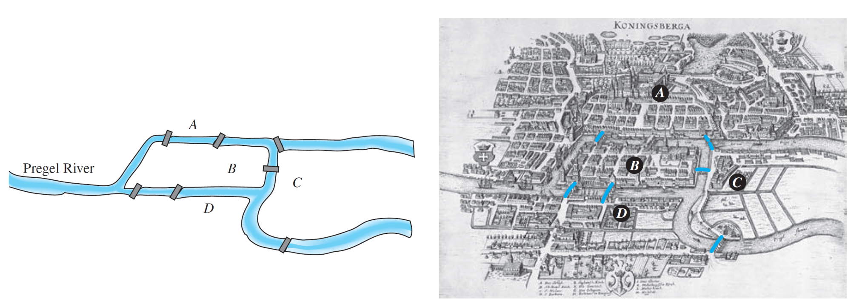
Trails, Paths, and Circuits
These were connected by seven bridges as shown in
Figure 10.2.1.
The Seven Bridges of Königsberg
Figure 10.2.1

Slide 5
Trails, Paths, and Circuits
The question is this: Is it possible for a person to take a walk around town, starting and ending at the same location and crossing each of the seven bridges exactly once?
To solve this puzzle, Euler translated it into a graph theory problem. He noticed that all points of a given land mass can be identified with each other since a person can travel
from any one point to any other point of the same land mass without crossing a bridge.

Slide 6
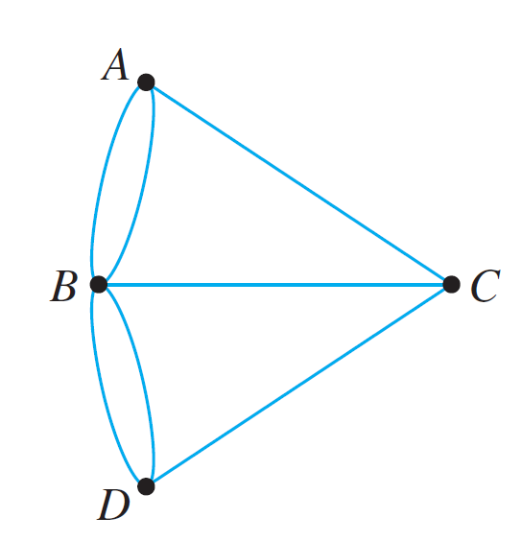
Trails, Paths, and Circuits
Thus for the purpose of solving the puzzle, the map of Königsberg can be identified with the graph shown in Figure 10.2.2, in which the vertices A, B, C, and D represent land masses and the seven edges represent the seven bridges.
Graph Version of Königsberg Map
Figure 10.2.2

Slide 7
Trails, Paths, and Circuits
In terms of this graph, the question becomes the following:
Is it possible to find a route through the graph that starts
and ends at some vertex, one of A, B, C, or D, and
traverses each edge exactly once?
Equivalently:
Is it possible to trace this graph, starting and ending at
the same point, without ever lifting your pencil from the
paper?

Slide 8
Trails, Paths, and Circuits
Take a few minutes to think about the question yourself. Can you find a route that meets the requirements? Try it!
Looking for a route is frustrating because you continually find yourself at a vertex that does not have an unused edge on which to leave, while elsewhere there are unused edges that must still be traversed.
If you start at vertex A, for example, each time you pass through vertex B, C, or D, you use up two edges because you arrive on one edge and depart on a different one.

Slide 9
Trails, Paths, and Circuits
So, if it is possible to find a route that uses all the edges of the graph and starts and ends at A, then the total umber of arrivals and departures from each vertex B, C, and D must be a multiple of 2.
Or, in other words, the degrees of the vertices B, C, and D must be even.
But they are not: deg(B) = 5, deg(C) = 3, and deg(D) = 3. Hence there is no route that solves the puzzle by starting and ending at A.

Slide 10
Trails, Paths, and Circuits
Similar reasoning can be used to show that there are no routes that solve the puzzle by starting and ending at B, C, or D.
Therefore, it is impossible to travel all around the city crossing each bridge exactly once.

Slide 11
Definitions

Slide 12
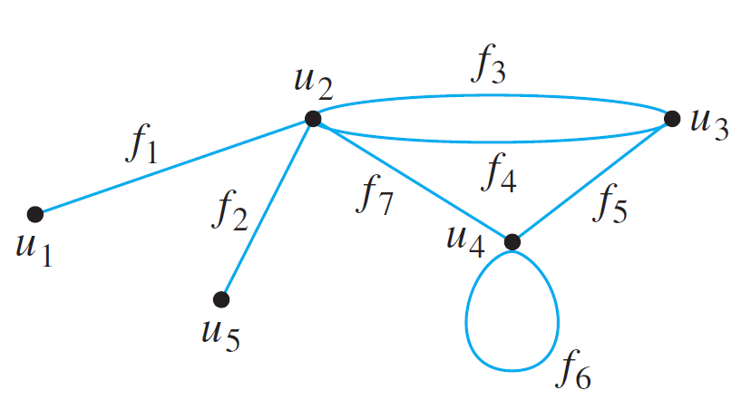
Definitions
Travel in a graph is accomplished by moving from one vertex to another along a sequence of adjacent edges.
In the graph below, for instance, you can go from u₁ to u₄ by taking f₁ to u₂ and then f₇ to u₄. This is represented by writing u₁f₁u₂f₇u₄.

Slide 13
Definitions
Or you could take the roundabout route
Certain types of sequences of adjacent vertices and edges are of special importance in graph theory: those that do not
have a repeated edge, those that do not have a repeated
vertex, and those that start and end at the same vertex.

Slide 14
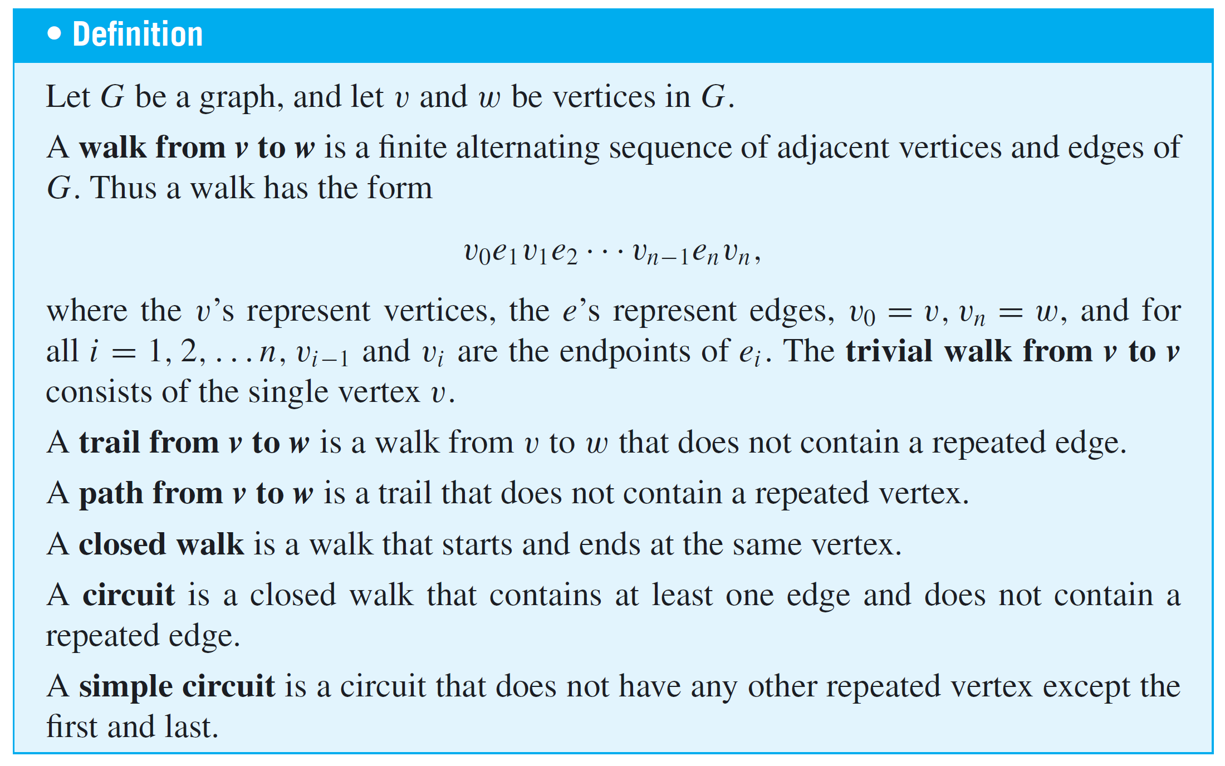
Definitions

Slide 15
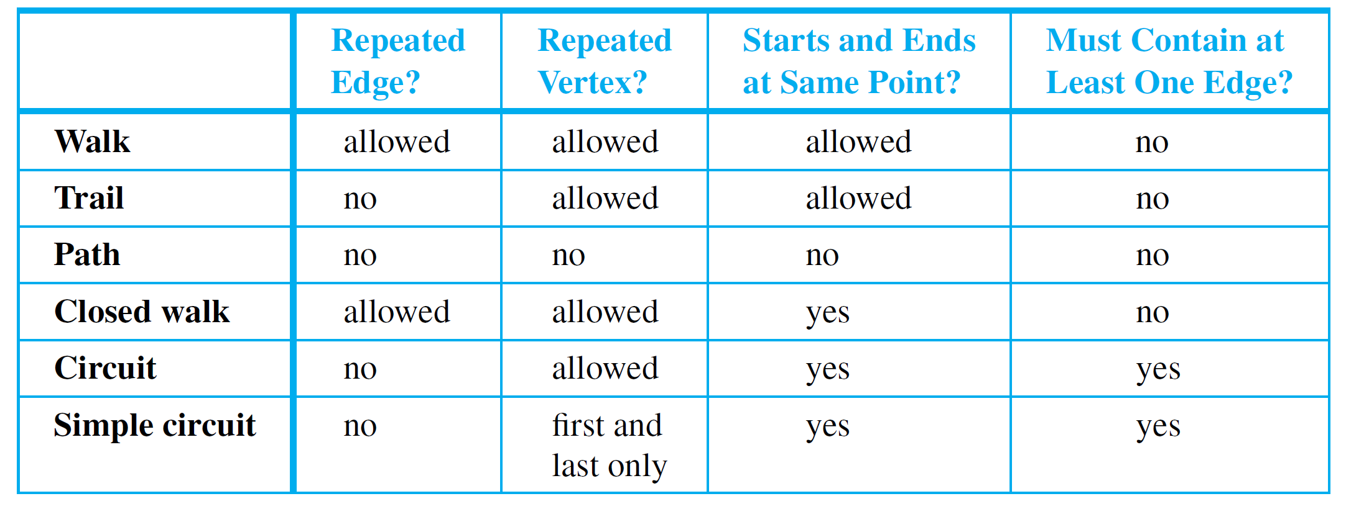
Definitions
For ease of reference, these definitions are summarized in the following table:
Often a walk can be specified unambiguously by giving either a sequence of edges or a sequence of vertices.

Slide 16






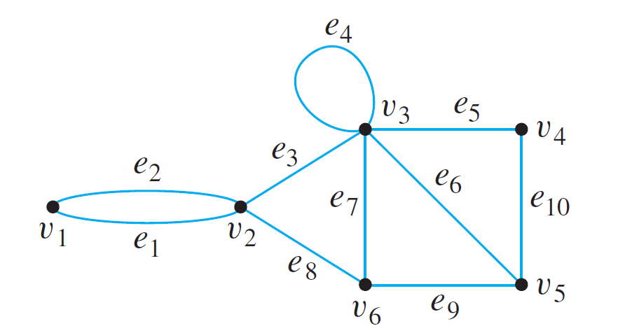
Example 2 – Walks, Trails Paths, and Circuits
In the graph below, determine which of the following walks are trails, paths, circuits, or simple circuits.
a. b. c.
d. e. f.

Slide 17
Example 2 – Solution
a. This walk has a repeated vertex but does not have a
repeated edge, so it is a trail from v₁ to v₄ but not a path.
b. This is just a walk from v₁ to v₅. It is not a trail because it
has a repeated edge.
c. This walk starts and ends at v₂, contains at least one
edge, and does not have a repeated edge, so it is a
circuit. Since the vertex v₃ is repeated in the middle, it is
not a simple circuit.
d. This walk starts and ends at v₂, contains at least one
edge, does not have a repeated edge, and does not
have a repeated vertex. Thus it is a simple circuit.

Slide 18
Example 2 – Solution
cont’d
e. This is just a closed walk starting and ending at v₁. It is not a circuit because edge e₁ is repeated.
f. The first vertex of this walk is the same as its last vertex, but it does not contain an edge, and so it is not a circuit. It is a closed walk from v₁ to v₁. (It is also a trail from v₁ to v₁.)

Slide 19
Definitions
Because most of the major developments in graph theory have happened relatively recently and in a variety of different contexts, the terms used in the subject have not been standardized.
For example, what this book calls a graph is sometimes called a multigraph, what this book calls a simple graph is sometimes called a graph, what this book calls a vertex is sometimes called a node, and what this book calls an edge is sometimes called an arc.

Slide 20
Definitions
Similarly, instead of the word trail, the word path is sometimes used; instead of the word path, the words simple path are sometimes used; and instead of the words simple circuit, the word cycle is sometimes used.
The terminology in this book is among the most common, but if you consult other sources, be sure to check their definitions.

Slide 21
Connectedness

Slide 22
Connectedness
It is easy to understand the concept of connectedness on an intuitive level.
Roughly speaking, a graph is connected if it is possible to travel from any vertex to any other vertex along a sequence of adjacent edges of the graph.

Slide 23
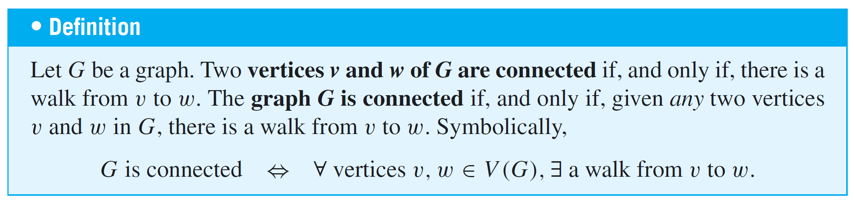
Connectedness
The formal definition of connectedness is stated in terms of
walks.
If you take the negation of this definition, you will see that a graph G is not connected if, and only if, there are two vertices of G that are not connected by any walk.

Slide 24
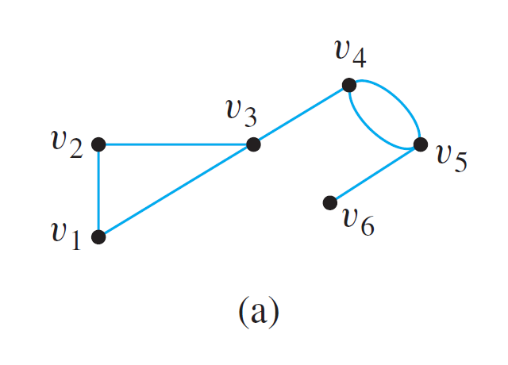
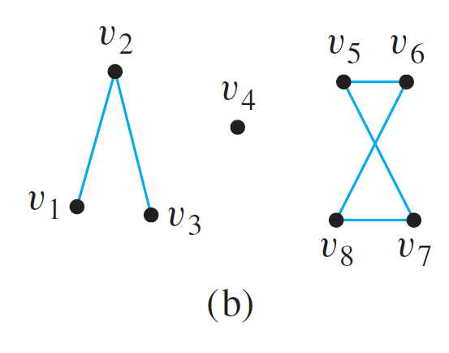
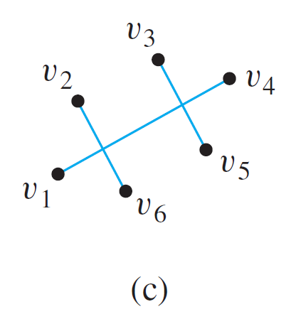
Example 3 – Connected and Disconnected Graphs
Which of the following graphs are connected?

Slide 25
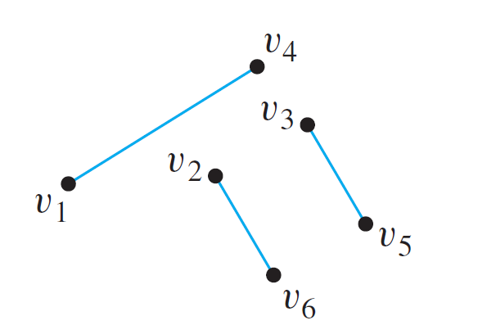
Example 3 – Solution
The graph represented in (a) is connected, whereas those of (b) and (c) are not. To understand why (c) is not connected, we know that in a drawing of a graph, two edges may cross at a point that is not a vertex.
Thus the graph in (c) can be redrawn as follows:

Slide 26
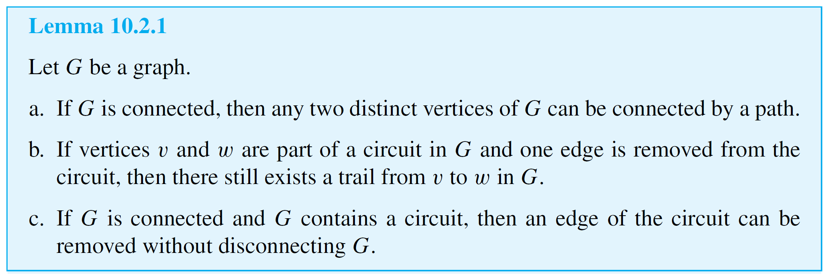
Connectedness
Some useful facts relating circuits and connectedness are collected in the following lemma.

Slide 27
Connectedness
The graphs in (b) and (c) are both made up of three pieces, each of which is itself a connected graph.
A connected component of a graph is a connected subgraph of largest possible size.

Slide 28
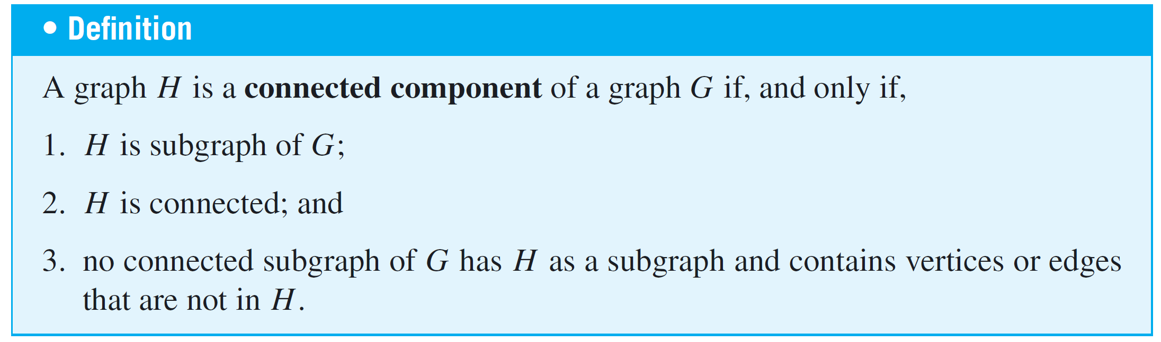
Connectedness
The fact is that any graph is a kind of union of its connected components.

Slide 29
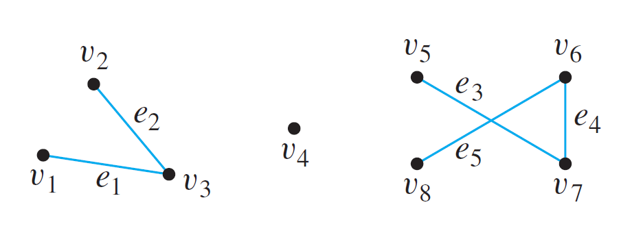

Example 4 – Connected Components
Find all connected components of the following graph G.
Solution:
G has three connected components: H₁, H₂, and H₃ with vertex sets V₁, V₂, and V₃ and edge sets E₁, E₂, and E₃, where

Slide 30
Euler Circuits

Slide 31
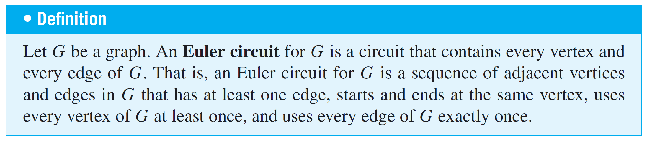
Euler Circuits
Now we return to consider general problems similar to the puzzle of the Königsberg bridges.
The following definition is made in honor of Euler.

Slide 32
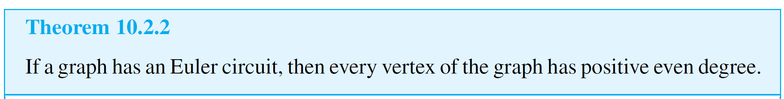
Euler Circuits
The analysis used earlier to solve the puzzle of the Königsberg bridges generalizes to prove the following theorem:

Slide 33
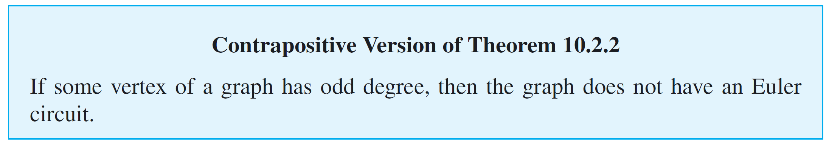
Euler Circuits
We know that the contrapositive of a statement is logically equivalent to the statement.
The contrapositive of Theorem 10.2.2 is as follows:
This version of Theorem 10.2.2 is useful for showing that a given graph does not have an Euler circuit.

Slide 34
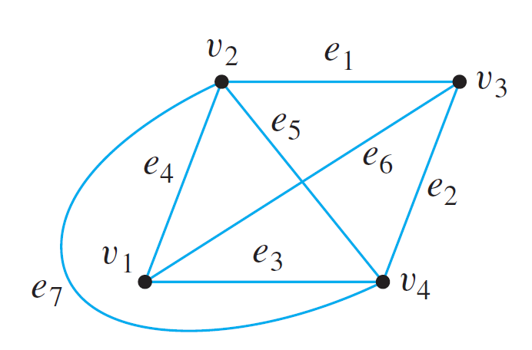
Example 5 – Showing That a Graph Does Not Have an Euler Circuit
Show that the graph below does not have an Euler circuit.
Solution:
Vertices v₁ and v₃ both have degree 3, which is odd. Hence by (the contrapositive form of) Theorem 10.2.2, this graph does not have an Euler circuit.

Slide 35
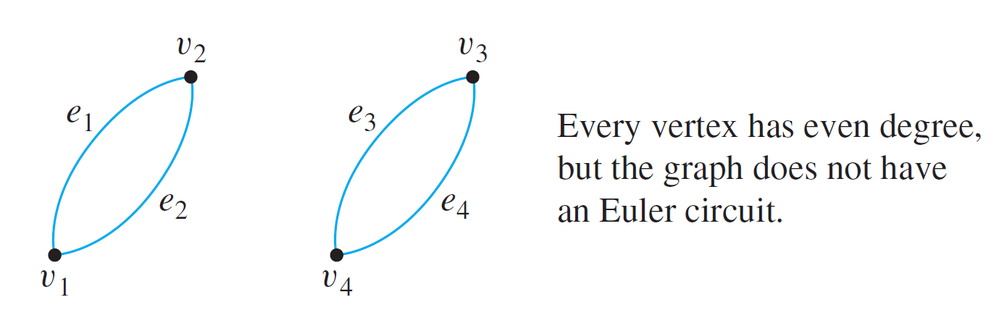
Euler Circuits
Now consider the converse of Theorem 10.2.2: If every vertex of a graph has even degree, then the graph has an Euler circuit. Is this true?
The answer is no. There is a graph G such that every vertex of G has even degree but G does not have an Euler circuit. In fact, there are many such graphs. The illustration below shows one example.

Slide 36
Euler Circuits
Note that the graph in the preceding drawing is not connected.
It turns out that although the converse of Theorem 10.2.2 is false, a modified converse is true: If every vertex of a graph has positive even degree and if the graph is connected, then the graph has an Euler circuit.

Slide 37
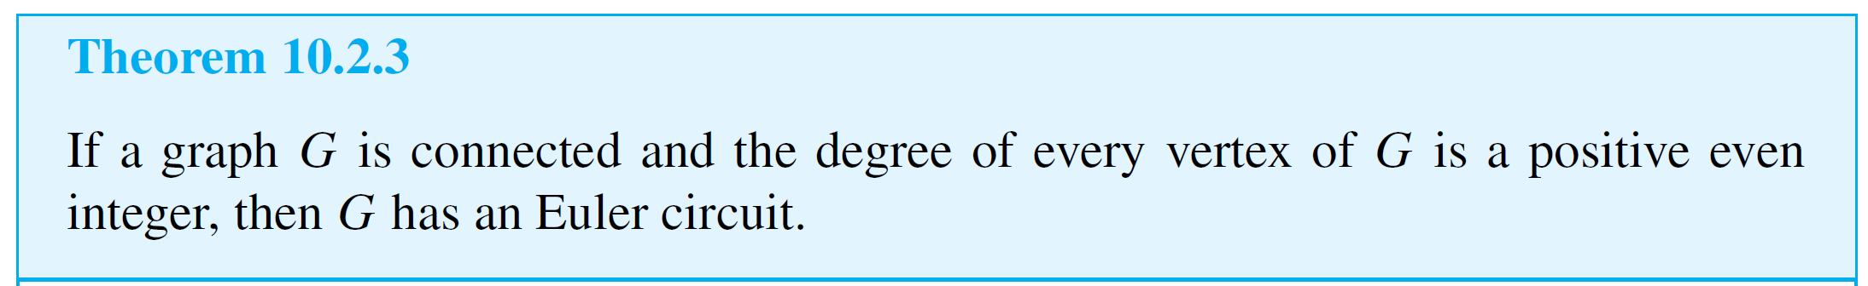
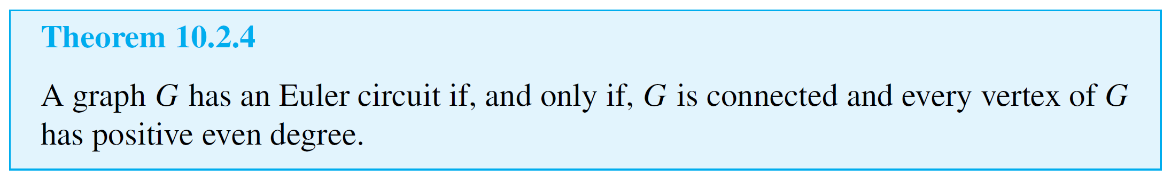
Euler Circuits
The proof of this fact is constructive: It contains an algorithm to find an Euler circuit for any connected graph in which every vertex has even degree.

Slide 38
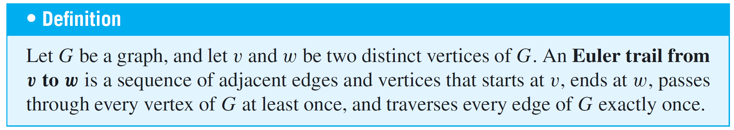
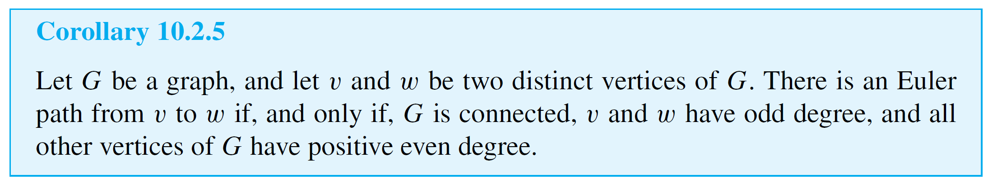
Euler Circuits
A corollary to Theorem 10.2.4 gives a criterion for
determining when it is possible to find a walk from one vertex of a graph to another, passing through every vertex of the graph at least once and every edge of the graph exactly once.

Slide 39
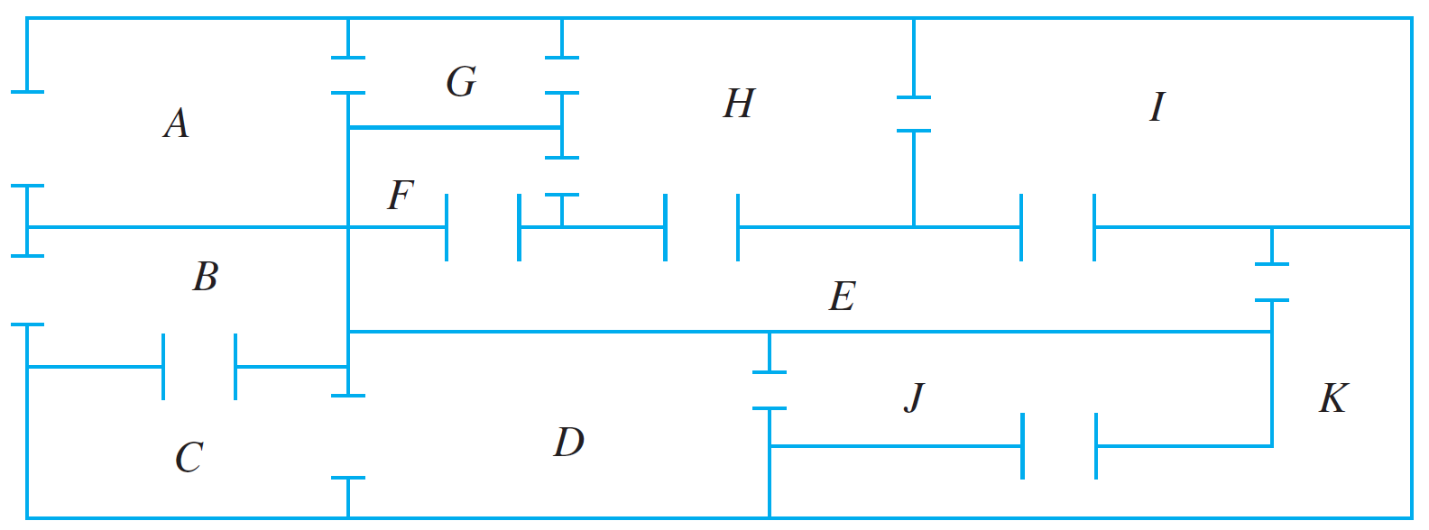
Example 7 – Finding an Euler Trail
The floor plan shown below is for a house that is open for public viewing. Is it possible to find a trail that starts in room A, ends in room B, and passes through every interior doorway of the house exactly once? If so, find such a trail.

Slide 40
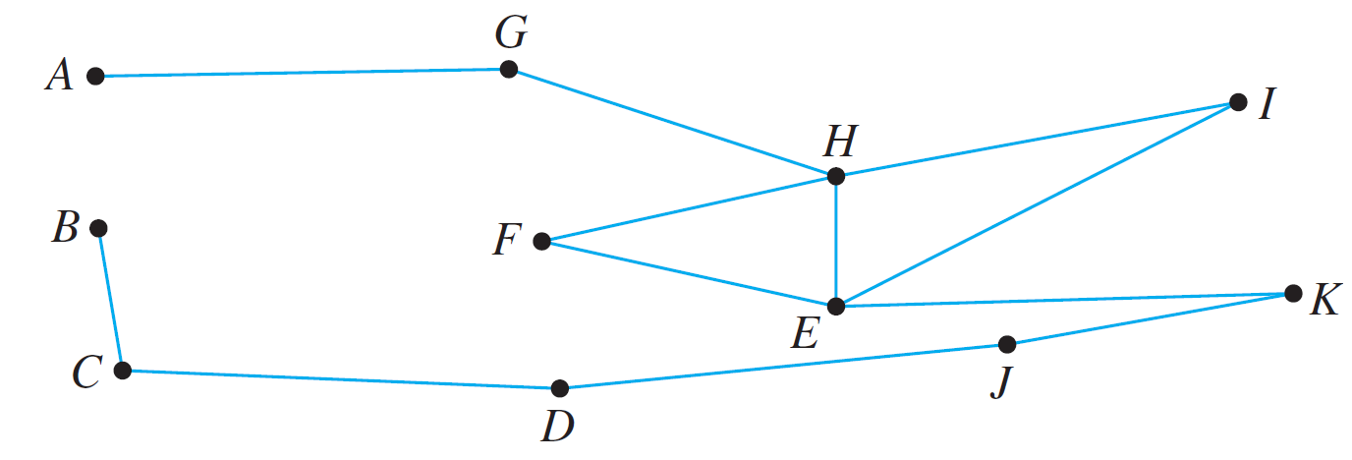
Example 7 – Solution
Let the floor plan of the house be represented by the graph below.
Each vertex of this graph has even degree except for A and B, each of which has degree 1.
Hence by Corollary 10.2.5, there is an Euler path from A to B. One such trail is
AGHFEIHEKJDCB.

Slide 41
Hamiltonian Circuits

Slide 42
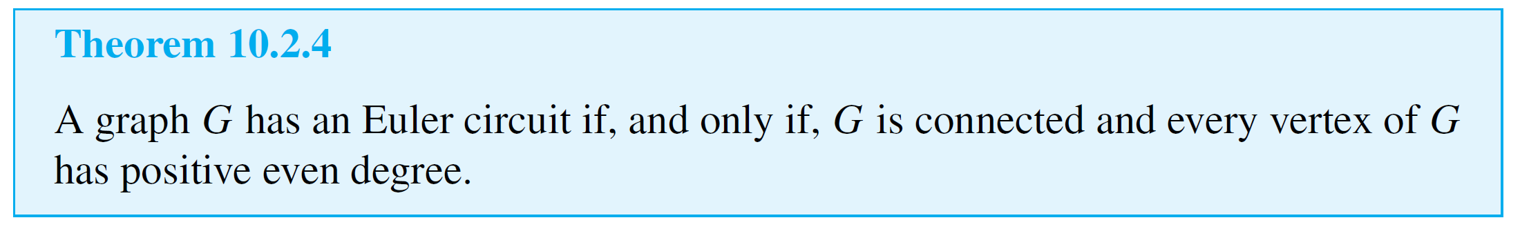
Hamiltonian Circuits
Theorem 10.2.4 completely answers the following question:
Given a graph G, is it possible to find a circuit for G in which all the edges of G appear exactly once?
A related question is this: Given a graph G, is it possible to find a circuit for G in which all the vertices of G (except the first and the last) appear exactly once?

Slide 43
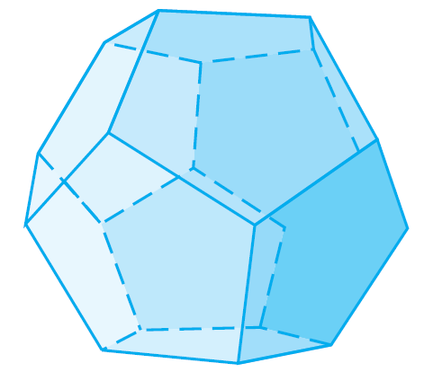
Hamiltonian Circuits
In 1859 the Irish mathematician Sir William Rowan Hamilton introduced a puzzle in the shape of a dodecahedron
(DOH-dek-a-HEE-dron). (Figure 10.2.6 contains a drawing of a dodecahedron, which is a solid figure with 12 identical pentagonal faces.)
Dodecahedron
Figure 10.2.6

Slide 44
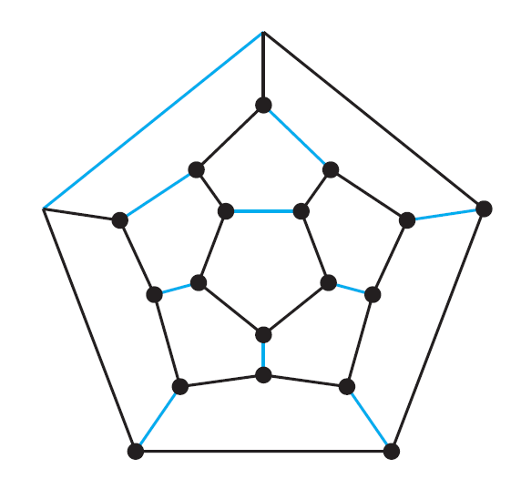
Hamiltonian Circuits
Each vertex was labeled with the name of a city—London, Paris, Hong Kong, New York, and so on.
The problem Hamilton posed was to start at one city and tour the world by visiting each other city exactly once and returning to the starting city.
One way to solve the puzzle is to imagine the surface of the dodecahedron stretched out and laid flat in the plane, as follows:

Slide 45
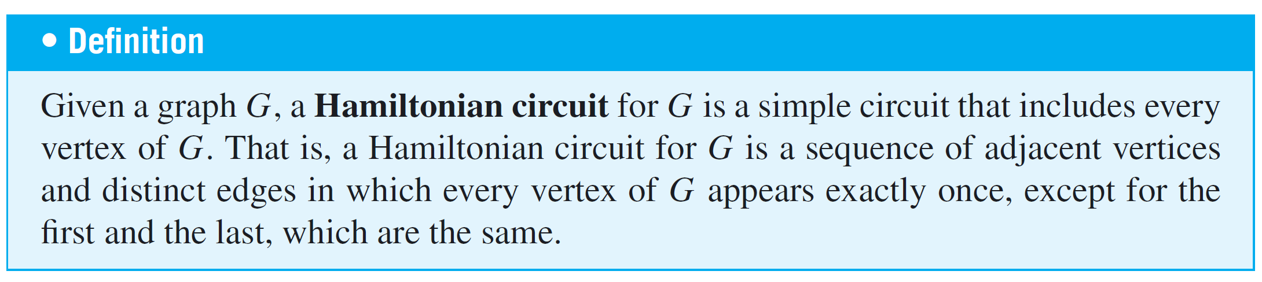
Hamiltonian Circuits
The circuit denoted with black lines is one solution. Note that although every city is visited, many edges are omitted from the circuit. (More difficult versions of the puzzle
required that certain cities be visited in a certain order.)
The following definition is made in honor of Hamilton.

Slide 46
Hamiltonian Circuits
Note that although an Euler circuit for a graph G must include every vertex of G, it may visit some vertices more than once and hence may not be a Hamiltonian circuit.
On the other hand, a Hamiltonian circuit for G does not need to include all the edges of G and hence may not be an Euler circuit.
Despite the analogous-sounding definitions of Euler and Hamiltonian circuits, the mathematics of the two are very different.

Slide 47
Hamiltonian Circuits
Theorem 10.2.4 gives a simple criterion for determining whether a given graph has an Euler circuit.
Unfortunately, there is no analogous criterion for determining whether a given graph has a Hamiltonian circuit, nor is there even an efficient algorithm for finding such a circuit.

Slide 48
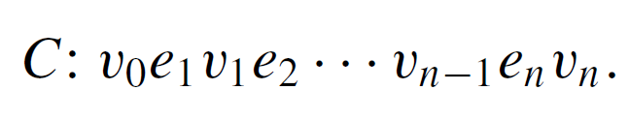
Hamiltonian Circuits
There is, however, a simple technique that can be used in many cases to show that a graph does not have a Hamiltonian circuit.
This follows from the following considerations:
Suppose a graph G with at least two vertices has a Hamiltonian circuit C given concretely as
Since C is a simple circuit, all the e_{i} are distinct and all the v_{j} are distinct except that v₀ = v_{n}. Let H be the subgraph of G that is formed using the vertices and edges of C.

Slide 49
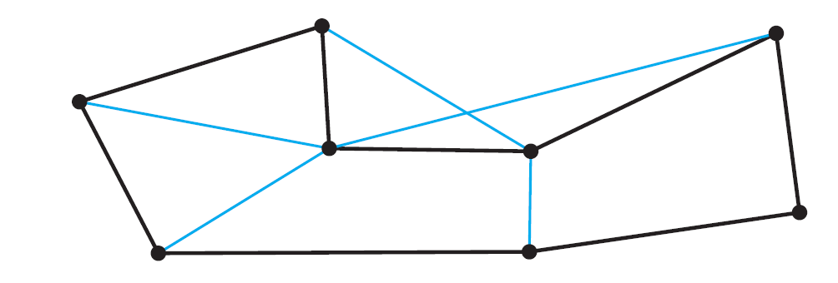

Hamiltonian Circuits
An example of such an H is shown below.
Note that H has the same number of edges as it has vertices since all its n edges are distinct and so are its n vertices v₁, v₂, . . . , v_{n}.
Also, by definition of Hamiltonian circuit, every vertex of G is a vertex of H, and H is connected since any two of its vertices lie on a circuit. In addition, every vertex of H has degree 2.

Slide 50
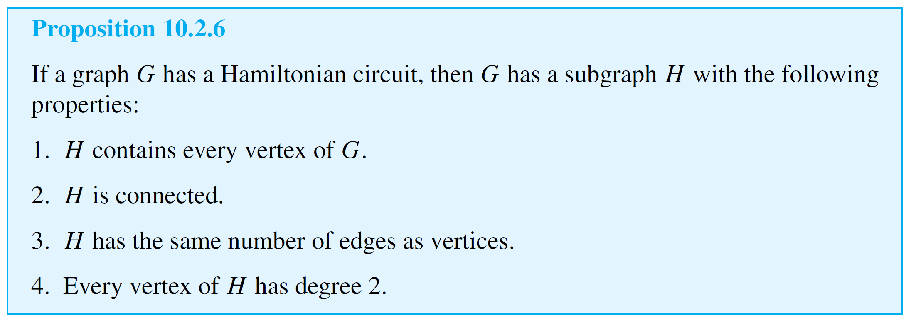
Hamiltonian Circuits
The reason for this is that there are exactly two edges incident on any vertex. These are e_{i} and e_{i+1} for any vertex v_{i} except v₀ = v_{n}, and they are e₁ and e_{n} for v₀ (= v_{n}).
These observations have established the truth of the following proposition in all cases where G has at least two vertices.

Slide 51
Hamiltonian Circuits
Note that if G contains only one vertex and G has a Hamiltonian circuit, then the circuit has the form v e v, where v is the vertex of G and e is an edge incident on v.
In this case, the subgraph H consisting of v and e satisfies conditions (1)–(4) of Proposition 10.2.6.

Slide 52
Hamiltonian Circuits
We know that the contrapositive of a statement is logically
equivalent to the statement.
The contrapositive of Proposition 10.2.6 says that if a graph
G does not have a subgraph H with properties (1)–(4), then G does not have a Hamiltonian circuit.
The next example illustrates a type of problem known as a traveling salesman problem. It is a variation of the problem of finding a Hamiltonian circuit for a graph.

Slide 53
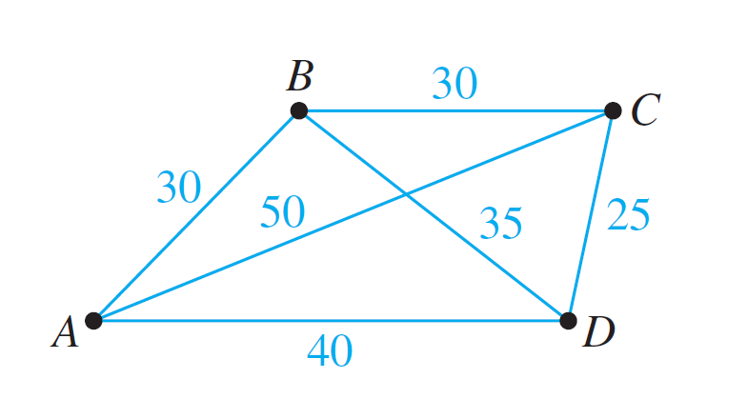
Example 9 – A Traveling Salesman Problem
Imagine that the drawing below is a map showing four cities and the distances in kilometers between them.
Suppose that a salesman must travel to each city exactly once, starting and ending in city A. Which route from city to city will minimize the total distance that must be traveled?

Slide 54
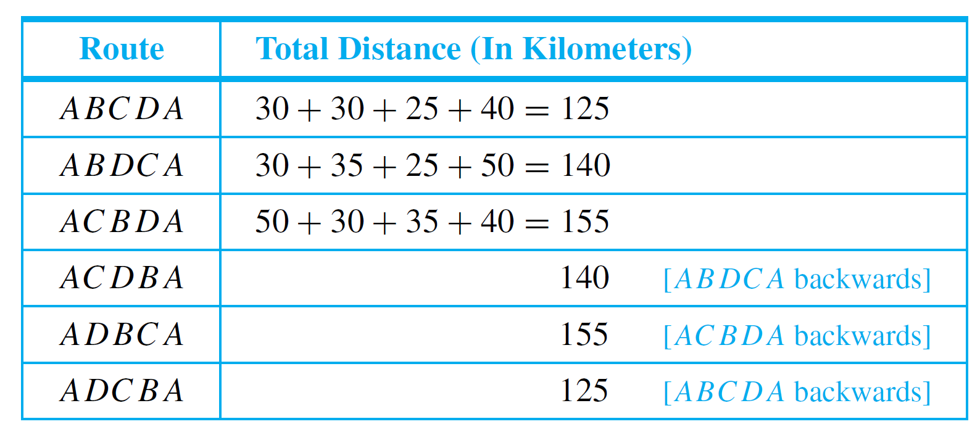
Example 9 – Solution
This problem can be solved by writing all possible Hamiltonian circuits starting and ending at A and calculating the total distance traveled for each.
Thus either route ABCDA or ADCBA gives a minimum total distance of 125 kilometers.

Slide 55
Hamiltonian Circuits
The general traveling salesman problem involves finding a Hamiltonian circuit to minimize the total distance traveled for an arbitrary graph with n vertices in which each edge is marked with a distance.
One way to solve the general problem is to use the method of Example 9: Write down all Hamiltonian circuits starting and ending at a particular vertex, compute the total distance for each, and pick one for which this total is minimal.

Slide 56

Hamiltonian Circuits
However, even for medium-sized values of n this method is impractical.
For a complete graph with 30 vertices, there would be
Hamiltonian circuits starting and ending at a particular vertex to check.
Even if each circuit could be found and its total distance computed in just one nanosecond, it would require approximately 1.4 × 10¹⁴ years to finish the computation.

Slide 57
Hamiltonian Circuits
At present, there is no known algorithm for solving the general traveling salesman problem that is more efficient.
However, there are efficient algorithms that find “pretty good” solutions—that is, circuits that, while not necessarily having the least possible total distances, have smaller total distances than most other Hamiltonian circuits.

